Slide 1
Neural Image Caption Generation with Visual Attention
Group:
Anitesh Lal
Shengzhi Liu
Edward Moradian

Slide 2
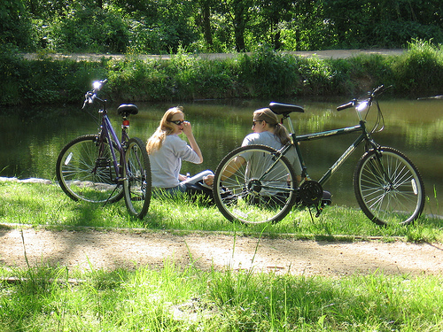
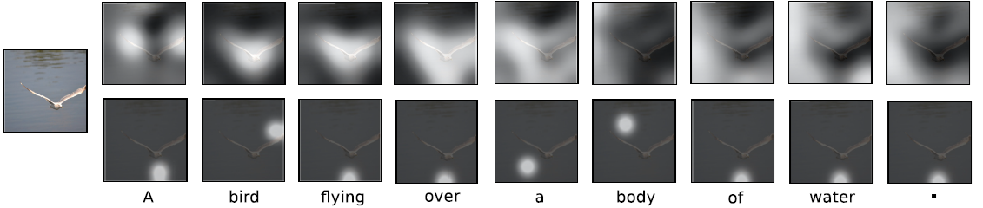
Previously

Slide 3


Multinoulli Distribution
Attention locations, the possible locations where the model should “focus” on, is sampled from a multinoulli distribution.
A multinoulli distribution is a generalization of the Bernoulli distribution. We can fit data into a Bernoulli distribution to do statistical analysis when we have one event with two possible outcomes and the variable of interest is discrete.
Instead of having only two possible outcomes (e.g., flip a heads or tails) the multinoulli has k possible outcomes (e.g., roll a 1, 2, 3 or 4)
Multinoulli Fit
Each K is a possible location to focus on from one annotation vector
The event is the one annotation vector given where we need to selectively attend to
Variable of interest is attention, which is discrete
Either attend to or do not attend to

Slide 4

Previously
To recap, the attention mechanism needs to compute the context vector Z(t). Z(t) being the “attention” or in the researchers words, “representation of the relevant part of the image input at time t”. Here, we treat z(t) as a random variable that changes over time t.
The annotation vectors L at a(i) which are the feature vectors (i.e., feature maps) that are created from the encoding CNN are inputted into the attention mechanism. These are a representation of part of the image at different image locations.
The attention mechanism needs to compute the weights, alpha, at each a(i).
For hard stochastic attention, we compute these weights α for each location i as what the probability is that location i is the right place to focus for producing the next word.

Slide 5
Find a Learning Rule for the Attention Model
Variational Bayesian Method of Using a Variational Lower Bound
Marginal log-likelihood = log p(y|a)
We want to optimize the marginal log-likelihood to derive our objective function or the learning rule. The marginal log-likelihood, however, is an intractable posterior distribution.
We can use Variational Bayes to approximate the theoretical distribution to
form an empirical distribution that is “close” in the sense of Kullback-Leiber divergence.

Slide 6
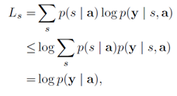
Variational Bayes Process
Process of Variational Bayes
Instead of maximizing the marginal log-likelihood, maximize only the variational lower bound of it. This lower bound is called the Evidence Lower Bound (ELBO).
When we do this we minimize the KL divergence. This is the mathematical grounds for Variational Bayes.
Use Jensen’s Inequality to derive an inequality from logp(y|a).
Left-hand side is the lower bound. Right-hand side is the upper bound.
Goal: Train the stochastic hard attention mechanism by maximizing an approximate variational lower bound on the marginal log-likelihood logp(y|a) of observing the sequence of words y given image features a.

Slide 7

Variational Bayes Process
Take the derivative of the lower bound with respect to the model parameter W, the weights, using the product rule.

Slide 8

Variational Bayes Process
Solve this partial derivative that is with respect to the weights (i.e., the parameter of the multinoulli distribution) using the Monte Carlo method to approximate this gradient. We are substituting Stochastic Gradient Descent with the Monte Carlo method because we are using Bayesian inference to an approximate distribution.
S^{~n} = (S^{n(1)}, S^{n(2)}, …) is a sequence of sampled attention locations
S^{n(t)} = Sample these locations from the multinoulli distribution defined before.

Slide 9
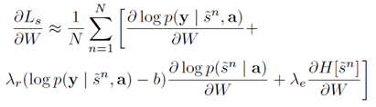
Variational Bayes Process
The final learning rule is:
This includes two regularizers to reduce the variance of the learning rule (i.e., control variates). The variance needs to be reduced as approximations using the Variational Bayes Method are prone to high variance. In the stochastic gradient estimates of the stochastic hard attention model there is high variance.
Moving average baseline technique
Add the gradient of the entropy of the multinoulli distribution
The learning rule has two hyperparameters
Lambda(r) and Lambda(e)

Slide 10
Main Idea
Create a maximum likelihood function as the learning rule
Create a learning rule that gives a function for the maximum likelihood that the attention region is where to focus on based on optimizing this function with respect to the weights (the parameters of the multinoulli distribution) at iterations of different sampled image locations.
Find the most probable locations to attend to that lead to the correct caption. Model this into a function - the maximum likelihood function to maximize this probability. Minimize the variance of this estimator using control variates.
Compute the weights based on this learning rule from the sampled multinoulli locations
The weight is the probability that the attention location i is the correct place to attend to given any previously selected for location and the annotation vectors.

Slide 11
Main Idea
The annotation vectors with the feature maps are pre-trained using transfer learning. These features maps can already be used classify common objects by name.
Train the model using the Variational Bayes with the Monte Carlo method to find the gradients on image datasets that already have captions.
Overall outcome: Attention model with the LSTM is now able to pick the most likely locations on each of the annotation vectors of an image to correctly produce a caption.

Slide 12
References and Further Research
Ba, Jimmy, Grosse, Roger, Salakhutdinov, Ruslan & Frey, Brendan. (2015). Learning Wake-Sleep Recurrent Attention Models, Advances in Neural Information Processing Systems, 28.
Paisley, John, Blei, David & Jordan, Michael. (2012). Variational Bayesian Inference with Stochastic Search. Proceedings of the 29th International Conference on Machine Learning, International Conference on Machine Learning, 2012, 2.
Ranganath, Rajesh, Gerrish, Sean & Blei, David M.. (2014). Black Box Variational Inference. Proceedings of the 17th International Conference on Artificial Intelligence and Statistics, Journal of Machine Learning Research, 33.
Xu, K., Ba, J. L., Ryan Kiros, K. C., Courville, A., Salakhutdinov, R., Zemel, R. S., & Bengio, Y. (2015). Show, Attend and Tell: Neural Image Caption Generation with Visual Attention. Journal of Machine Learning Research, 37, 2048-2057.
For more information on the Variational Bayes algorithm please see the online video lectures of Professor Tamara Broderick.

